Slide 1
Computer Organization 1
Instruction Set Architecture

Slide 2
Instruction Set Architecture
Different Types of Instruction:
Move (Load and store)
  Memory to memory; memory to CPU
  register to register
Arithmetic and Logic
  Add; shift; Compare
Branch
  change in direction of program flow
I/O
Miscellaneous
  Flag; Wait; Start; Stop

Slide 3
Arithmetic and Logic Instructions
AND one bit pattern with another
OR one bit pattern with another
NOR - means NOT OR - one bit pattern with another
NAND – NOT AND
Shift bit pattern Right/Left

Slide 4
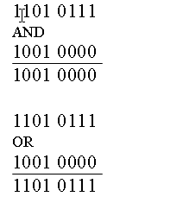
AND and OR examples

Slide 5
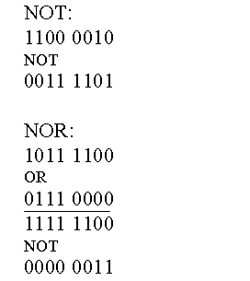
NOT and NOR (NOT OR)

Slide 6
Shift instructions
Logical shift:
0000 0000 0011 0001 eg Shift left 3 gives
0000 0001 1000 1000 ie copies zeros in to rightmost bits
Arithmetic Shift:
1000 0000 1100 0011 eg Shift R2 Arithmetic
1000 0000 0011 0000 ie preserves sign bit

Slide 7
Instruction Set Architecture
In general, a computer instruction consists of a function (Opcode) and one or more operands. For example,
ADD x, y
Add is the function or opcode; x and y are both operand addresses.
Operand addresses may refer to memory or registers.
We will look at how earlier machines with much smaller memories and CPUs implemented Move and Arithmetic operations.

Slide 8
Instruction Set Architecture
Earlier machines were often referred to by the number of operands allowed in an instruction. One-address, two-address and three-address computers were extant at different times.
Look at how this JAVA or C++ instruction could be implemented in each of these address modes:
  a = b * (c + d * e - f/g);

Slide 9
a = b * (c + d * e - f/g);
Memory traffic has two components: the instruction itself must be fetched from memory, and then data values must be fetched from memory to be acted upon. After that, data values may have to be restored to memory when the computation is complete.
Assume that each opcode occupies one byte, and that each memory address takes 2 bytes (allowing for a 64k byte memory).

Slide 10
a = b * (c + d * e - f/g); Three-address mode
  T1 and T2 below are temporary locations;
  we use (x) to mean 'the contents of location x’
mpy d, e, T1 // (d) * (e) -> T1
add c, T1, T1 // (c) + (T1) -> T1
div f, g, T2 // (g) / (f) -> T2
sub T2, T1, T1
mpy b, T1, a
That is, 5 instructions, each with 7 bytes (opcode and 3 2-byte addresses), have to be fetched. The program size is 35 bytes.

Slide 11
a = b * (c + d * e - f/g); Two-address mode
Try this approach:
mpy d,e //Result in e
div g,f // result in f
sub f,d // result in d
etc
Not a viable strategy -
because contents of e, f and d are overwritten by the operations; e, f and d may be needed in other calculations, so we must make additional moves

Slide 12
a = b * (c + d * e - f/g); Two-address mode
move d,a // (d) -> a
mpy e,a // result -> a
move f, T1 // (f) -> T1
div g, T1 // (T1)/ (g) -> T1
sub T1, a
add c, a
mpy b,a
That is, 7 instructions in 2-address mode. The program size is 7 x (1 + 2 + 2) = 35 bytes.

Slide 13
a = b * (c + d * e - f/g); One-address mode
One-address computer has an accumulator for intermediate results.
load f // (f) -> acc
div g // (acc) / (g)
store T1 // (acc) -> T1
load d // (d) -> acc
mpy e // (acc) * (e) -> acc
add c
sub T1
mpy b
store a

Slide 14
a = b * (c + d * e - f/g); One-address mode
……
sub T1
mpy b
store a
That is, 9 instructions for a one address mode.
Each instruction is 3 bytes long, so program size is 27 bytes.
The one-address machine has the smallest program size.
This goes some way to explaining the popularity of accumulator machines, given the high costs of both memory and registers.

Slide 15
a = b * (c + d * e - f/g); Stack mode
This uses other memory access instructions called Push and Pop. All calculations are done on data on top of the stack, which is a LIFO type structure – Last In, First Out.

Slide 16
a = b * (c + d * e - f/g); Stack mode
push b //push (b) on to the top level
push c //push (c) on to top level; b now next level
push d
push e
mpy // d * e -> top level
add // c + d*e -> top level
push f
push g
div // f/g ; result in top level
sub // (top level) from (2nd level); result->top
mpy // (top level) * b
pop a //(top level) -> a

Slide 17
a = b * (c + d * e - f/g); Stack mode
……..
div // f/g ; result in top level
sub // (top level) from (2nd level); result->top
mpy // (top level) * b
pop a //(top level) -> a
That is, 12 stack instructions; 5 zero address and 7 load and store.

Slide 18
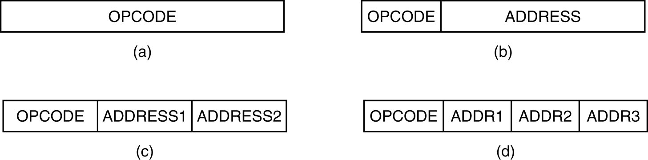
Instruction Formats (1)
Four common instruction formats:
(a) Zero-address instruction. (b) One-address instruction
(c) Two-address instruction. (d) Three-address instruction.

Slide 19
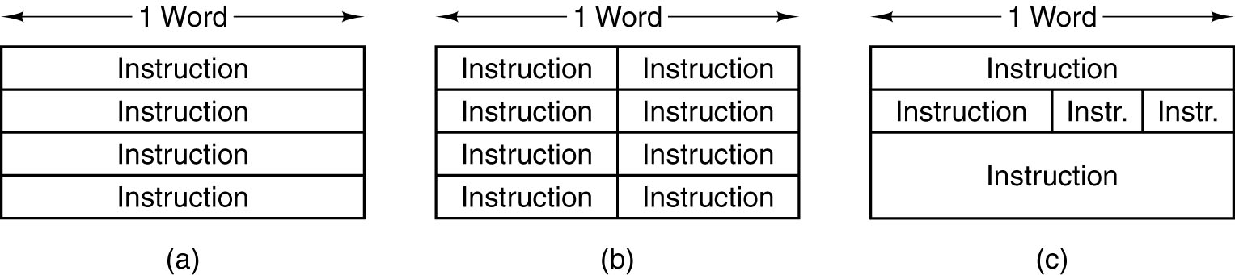
Instruction Formats (2)
Some possible relationships between instruction and word length.

Slide 20

Assembly Language Instruction Formats
3-Address instruction
Languages with instructions written in some or all of the above formats are called Assembly Languages (Low-level languages) and are near to the processor’s actual machine language.

Slide 21


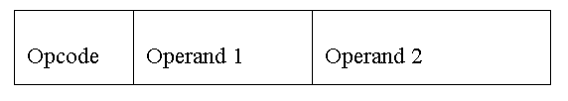

Assembly Language Instruction Formats
One Address Instruction
One-and-a-half Address instruction
Two Address Instruction
Register to Register Instruction

Slide 22
OPCODES
The opcodes in the previous slide are all fixed-length (8 bits, say); in modern machines, expanding opcodes are common
SPARC and Pentium 4 are examples

Slide 23
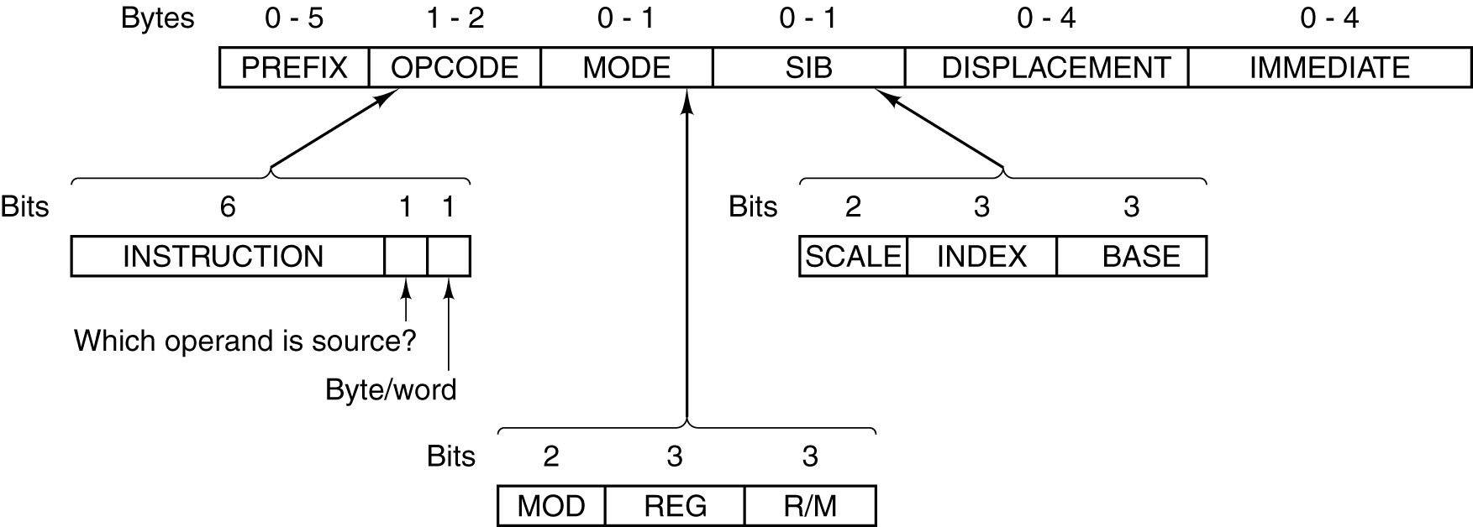
The Pentium 4 Instruction Formats
The Pentium 4 instruction formats.

Slide 24
The Pentium 4 Instruction Formats
The Pentium 4 is designed to be backward compatible, so that instructions designed for the Intel 8088 can run on every generation since
Can have up to 6 variable length fields, 5 of which are optional
In general, for 2-operand instructions, if one operand is in memory, the other must be in a register. That is, Reg toReg, Memory to Reg, Reg to Memory are allowed, but not memory to memory

Slide 25
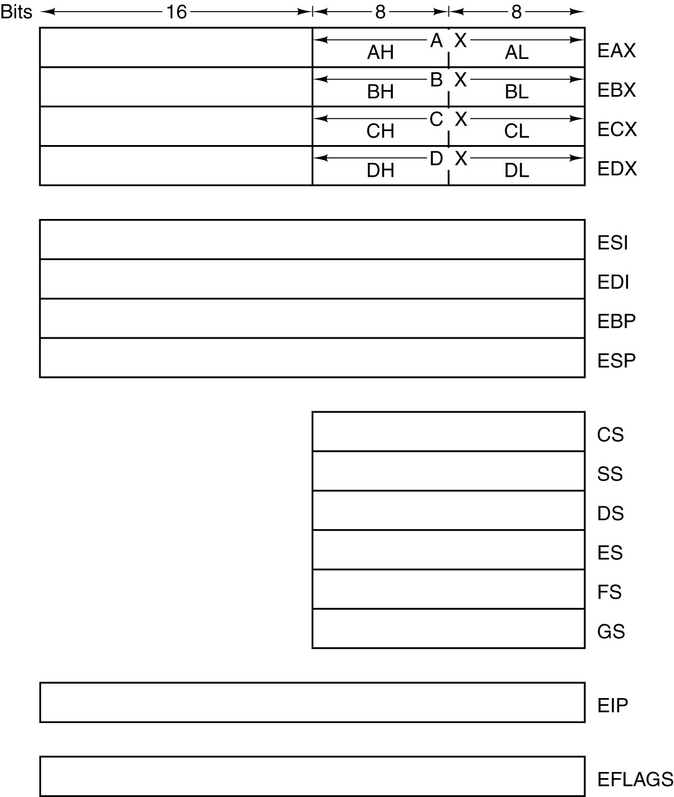
Overview of the Pentium 4
ISA Level
The Pentium 4’s primary
registers.

Slide 26
Pentium Registers
EIP (Extended Instruction Pointer) is the Program Counter
EFLAGS is the Program Status Word (PSW)
ESP the stack pointer
EAX is the main arithmetic register
EDX is used for multiply and divide
EAX and EDX hold 64-bit products and dividends
CS to GS are Segment Registers – hungover from when the 8088 addressed 2^20 bytes using 16-bit addresses

Slide 27
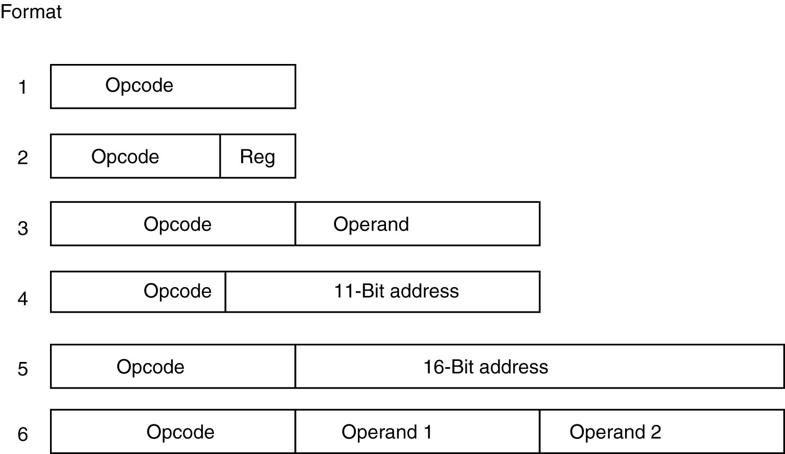
The 8051 Instruction Formats
The 8051 instruction formats.

Slide 28
Intel 8051
Used in embedded systems such as traffic lights, washing machines
Single chip holding CPU AND memory, device controllers
64KB for programs, (in ROM?)
64KB for data (in RAM?)

Slide 29
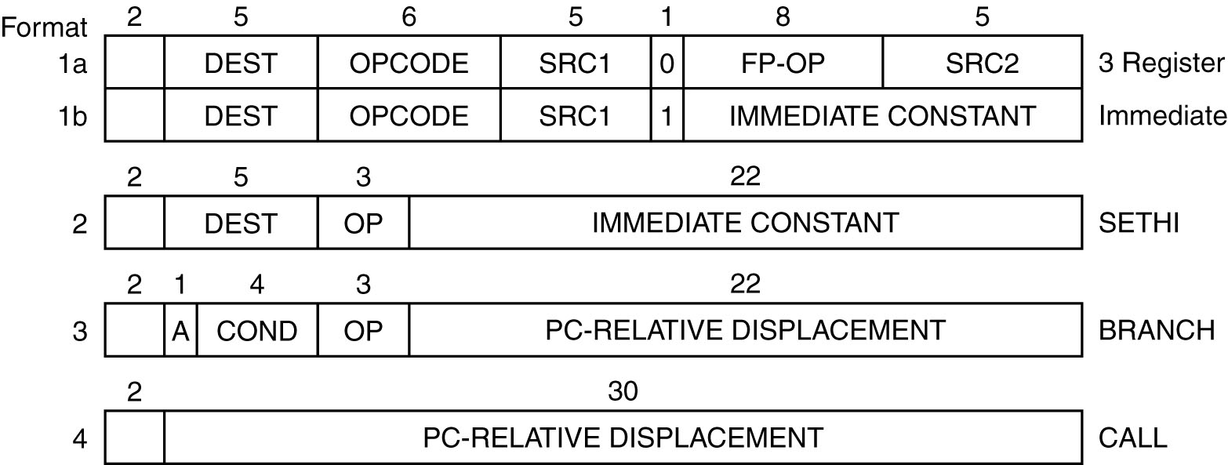
The UltraSPARC III Instruction Formats
The original SPARC instruction formats.

